Slide 1
Molten Planet Productions
An indie game development company by Lewis Hawkins

Slide 2
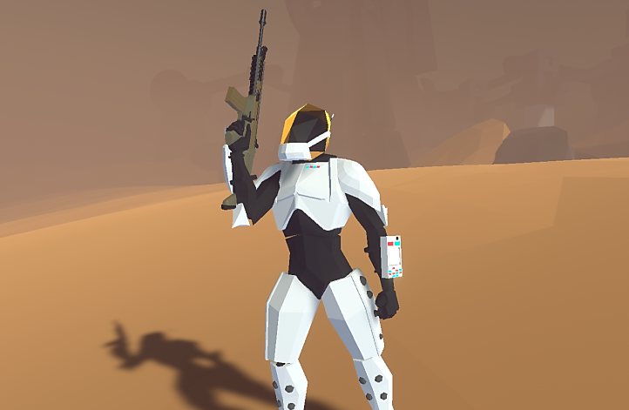
What is This Company?
Molten Planet Productions specializes in video game development. This company is currently making a game called Status Online, however will begin to broaden into selling game creation assets.

Slide 3
What products and Services are Currently Planned
1
Status Online: A Sci-Fi / RPG set in 2120 after the solar system is attacked by three alien races. Humanities on the brink of destruction and the player with new advanced exo-suits is tasked to take back earth and investigate other planets.
2
Library of 3D models: This company will provide an ever-expanding library of 3D art in which a license can be bought.
3
Unity Asset Store: Packages of game assets will be sold in the Unity Asset Store. These packages will include, animated models with scripts to provide an example of how they can be used.

Slide 4
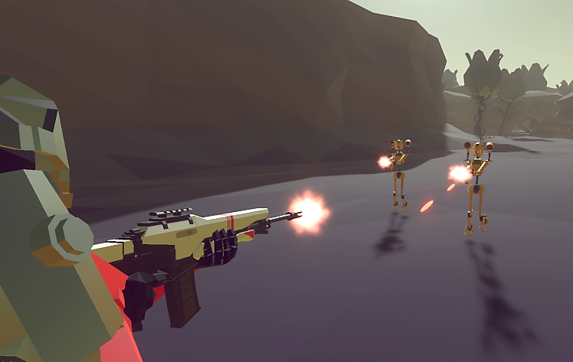
What is Status Online?
Status Online is a sci-fi / RPG video game that’s set in the year 2114. Five races have arrived at earth for an unknown reason and are warring with each other and humanity. The player as a British special forces soldier is introduced to a new military programme, which is prototyping new exo-suits, which provide damage resistance, increased strength, and powerful parkour abilities. The player and the rest of the special forces are tasked with taking back Earth, then the rest of the solar system, and find out why the aliens are here.
The main plot of the story unveils itself once the player discovers a new race known as the chosen. The chosen are a highly religious race, which when found are in the middle of a ritual.
Following the ritual the player is sent to Pluto in search of a “God” the Chosen are worshiping.
The player finds the “God”, referred to as the Creator in a ship under Pluto's crust. This ship is soon realised to be 450,000 years old, the same as the robots on Venus and strange Human bones. The story finally starts to add up.

Slide 5
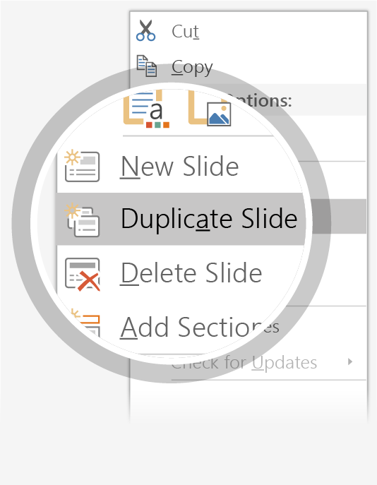
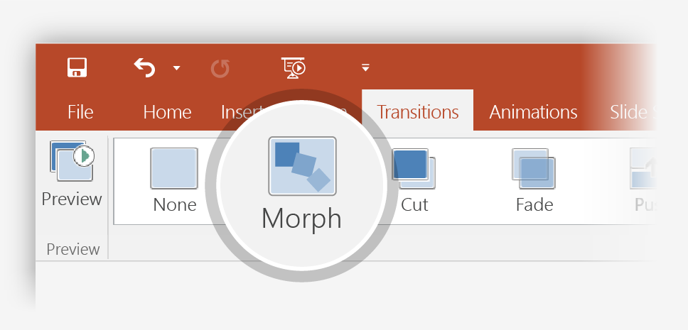

Setting up Morph
Try it yourself with these two simple “planets”:
1
Duplicate this slide: Right-click the slide thumbnail and select Duplicate Slide.
2
In the second of these two identical slides, change the shapes on the right in some way (move, resize, change color), then go to Transitions > Morph.
3
Return to the first of the two slides and press Slide Show button and then select Play to see your circle morph!
Hint: Effect Options gives you even more options for Morph.

Slide 6
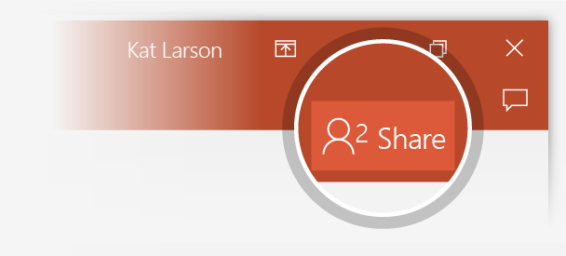
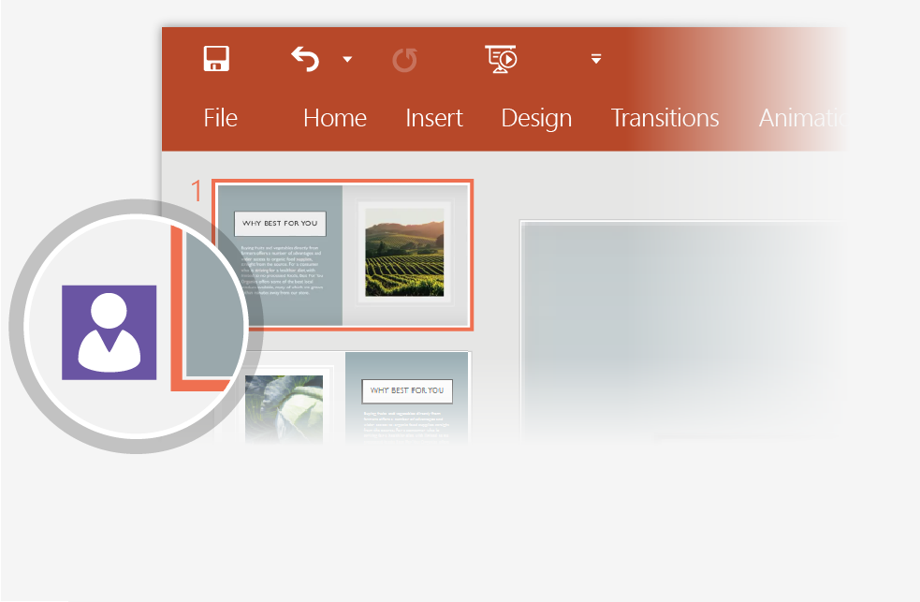

Working together in real time
When you share your presentation with others, you’ll see them working with you at the same time. How it works:
1
Select Share from above the ribbon, or by using short-key Alt-YU, to invite people to work with you (You can save to the cloud at this point.)
2
When other people are in the presentation, a marker shows who is on which slide…
3
…and the part of the slide they're editing.

Slide 7


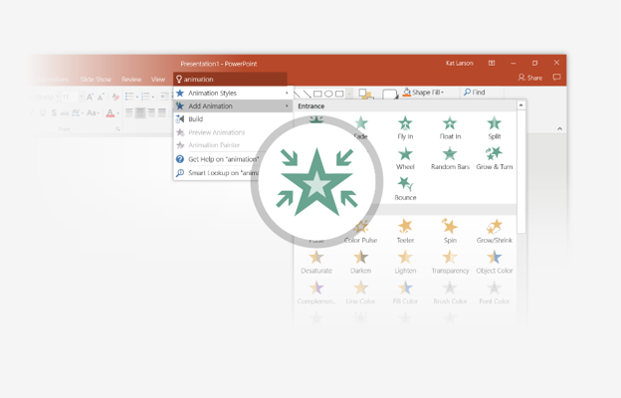
You’re an expert with Tell Me
The Tell Me box finds the right command when you need it, so you can save time and focus on your work. Try it:
SELECT ME
1
Select the Robot picture on the right.
2
Type animation in the Tell Me box, and then choose Add Animation.
3
Choose an animation effect, like Zoom, and watch what happens.

Slide 8
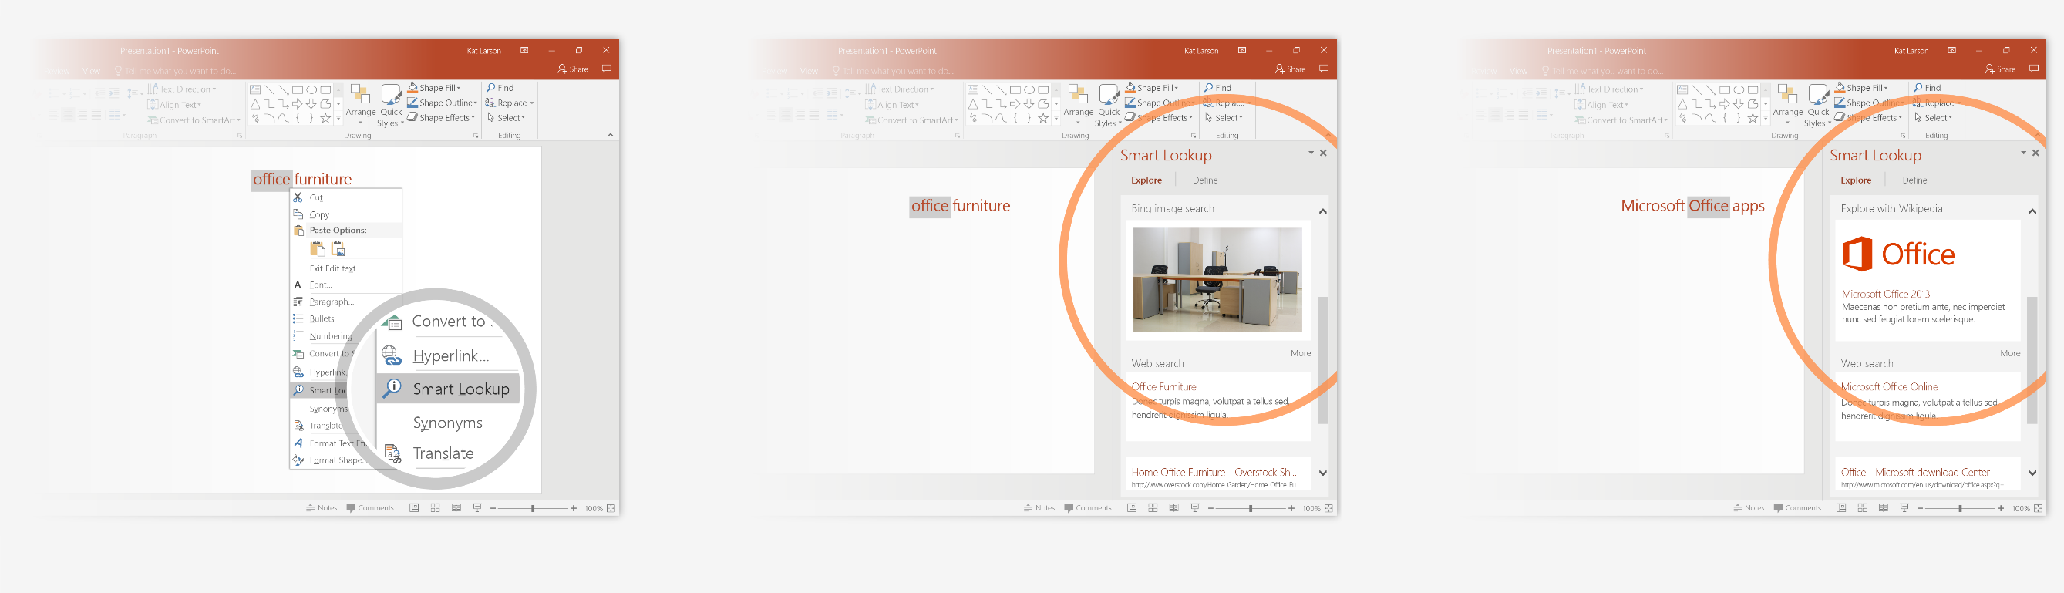
Explore without leaving your slides
Smart Lookup brings research directly in to PowerPoint. Try it:
1
Right-click in the word office in the following phrase: office furniture
2
Choose Smart Lookup, and notice that results are contextual for that phrase, not Microsoft Office apps.
3
Just for fun, try Smart Lookup again by right-clicking in the word Office in Step 2.

Slide 9

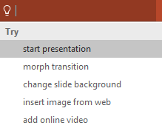

More questions about PowerPoint?
Select the Tell Me button and type what you want to know.
Visit the PowerPoint team blog
Go to free PowerPoint training
Give feedback about this tour
SELECT THE ARROW WHEN IN SLIDE SHOW MODE
Notes:
In Slide Show mode, select the arrows to visit links.

